Slide 1
Big Mountain Ticket Price Prediction
Guided Capstone Project

Slide 2
Problem identification
Big Mountain Resort ski resort is located in Montana.
Big Mountain suspects it may not be maximizing its returns.
Big Mountain doesn't have a good sense of evaluation of its facilities.
Build a predictive model for ticket price based on a number of facilities, or properties.

Slide 3
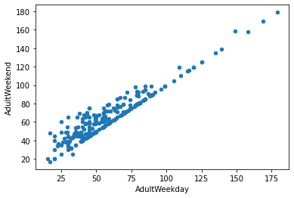
Problem identification
Linear relationship between Adult weekend and Adult weekday prices.
Adult weekend prices have fewer missing values.
Adult weekend is our target variable.

Slide 4
Recommendation and findings
After analyzing all the Business options, we recommend below steps:
Close five runs.
Add a run, increase vertical drop by 150 feet, add a chair lift.
Avoid adding 2 acres of snow making.
Don’t increase longest run by 0.2 miles and add 4 acres of snow making capability.

Slide 5
Modeling results and analysis
Features that came up as important in the modeling included:
vertical_drop
Snow Making_ac
total_chairs
fastQuads
Runs
LongestRun_mi
trams
SkiableTerrain_ac

Slide 6
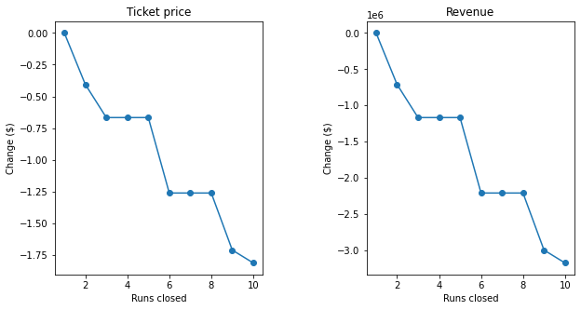
Modeling results and analysis
If Big Mountain decides to close down 3 runs, it may close 4 and 5 run.

Slide 7
Modeling results and analysis
Option 2: Big Mountain is adding a run, increasing the vertical drop by 150 feet, and installing an additional chair lift. This scenario increases support for ticket price by $1.99 and over the season, this could be expected to amount to $3474638.
Option 3: In this scenario, you are repeating the previous one but adding 2 acres of snow making. Result make no difference from previous ones.
Option 4: This scenario calls for increasing the longest run by .2 miles and guaranteeing its snow coverage by adding 4 acres of snow making capability. In this case also results make no difference.

Slide 8
Summary and conclusion
If Big Mountain is interested in closing down some facilities , it may close down up to 5 runs with some loss of revenue.
Big Mountain can add a run, increase the vertical drop by 150 feet, and install an additional chair lift. This could increase ticket prices by $1.99 and revenue by $3474638.
Adding 2 acres of snow making to previous steps make no changes in prices or revenue.
Increasing the longest run by .2 miles and guaranteeing its snow coverage by adding 4 acres of snow making capability also makes no differences in results.

